Slide 1
Collision Pass
Rendering Pass
Vertex Shader
Vertex Shader
Transform
Feedback
Geometry Shader
Geometry Shader
Fragment Shader
Fragment Shader

Slide 2
Particle Pass
Octree Pass
Update
&
Collision
(In GPU)
NodeTexture
Update
(In CPU)
SSBO_Node
SSBO_Particle
Rendering
Rendering

Slide 3
Particle Pass
Update & Collision
(In GPU)
Rendering
NodeTexture
SSBO_Nodes
SSBO_Particles
Octree Pass
Update
(In CPU)
Rendering
SSBO_Nodes
SSBO_Particles

Slide 4
CDT
순차적 탐색 그림 필요할까?

Slide 5
Transform Feedback Buffer Object
Particle
Position
Write
Transform Feedback
VBO
Vertex Shader
Geometry Shader
Fragment Shader
Collision
Detection
Texture
Collision System
Texture Lookup

Slide 6
Transform
Feedback
Buffer
Object
Transform Feedback
Particle
Position
Write
Vertex Shader
Geometry Shader
Fragment Shader
Collision
Detection
Texture
Collision System
Texture Lookup

Slide 7
Transform
Feedback
Buffer
Object
Vertex Shader
Geometry Shader
Fragment Shader
Rendering Particle
Make Billborad
Texture Mapping

Slide 8
Vertex Specification
Vertex Shader
Tessellation
Geometry Shader
Vertex Post-Processing
Primitive Assembly
Rasterization
Fragment Shader
Per-Sample Operations

Slide 9
DRAW Call 1
TBO1
Geometry Shader
TBO2
DRAW Call 2
TBO2
Geometry Shader
TBO1

Slide 10
Geometry Shader

Slide 11
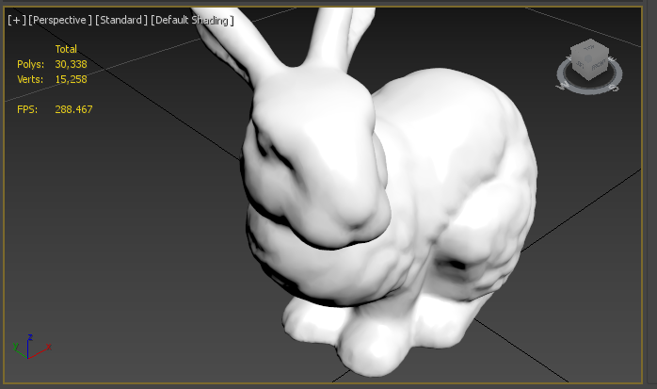
토끼 A 밀도
5
10
15
20

Slide 12
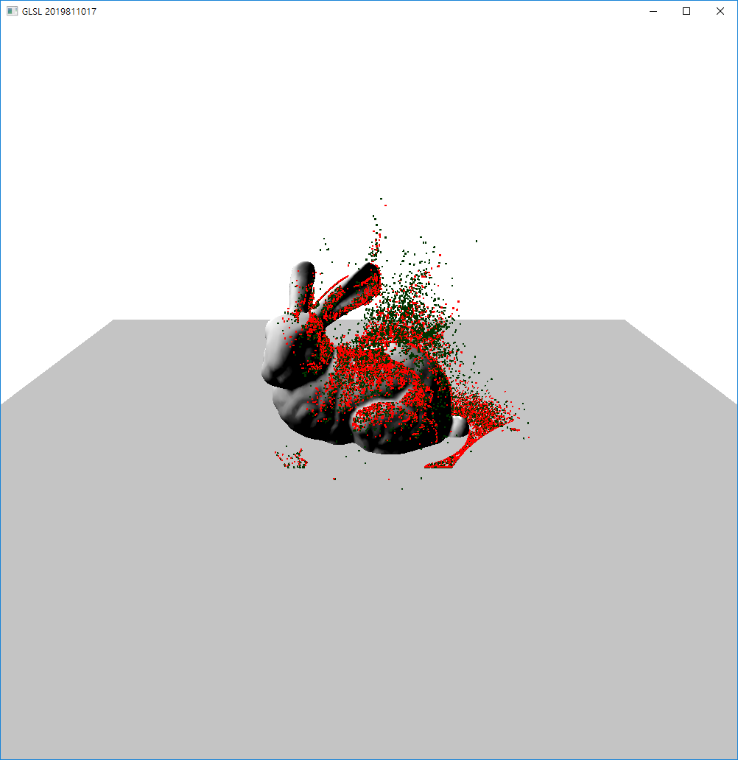
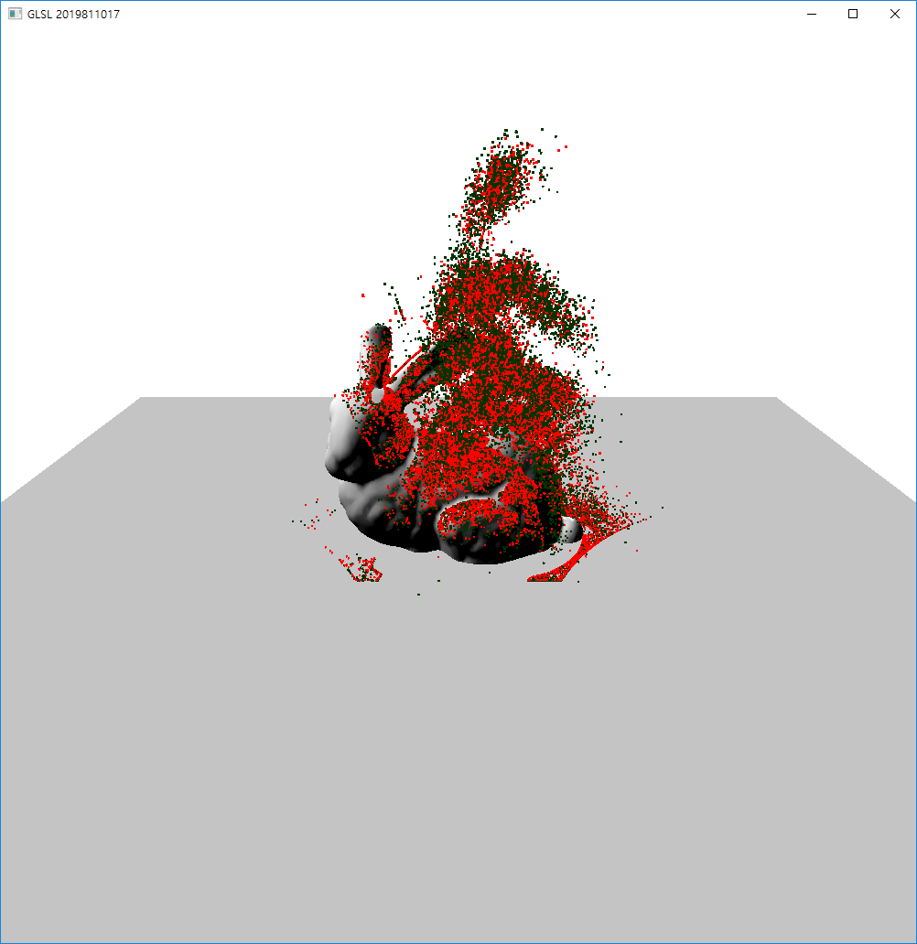
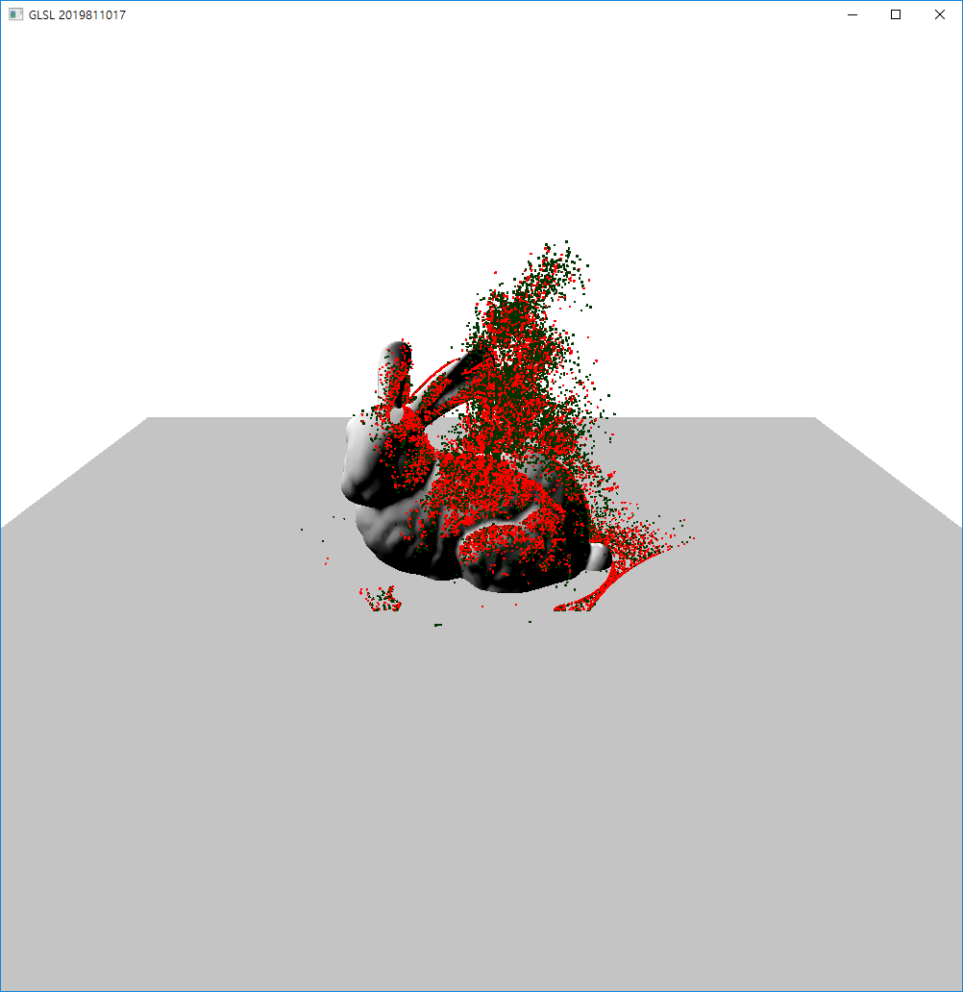
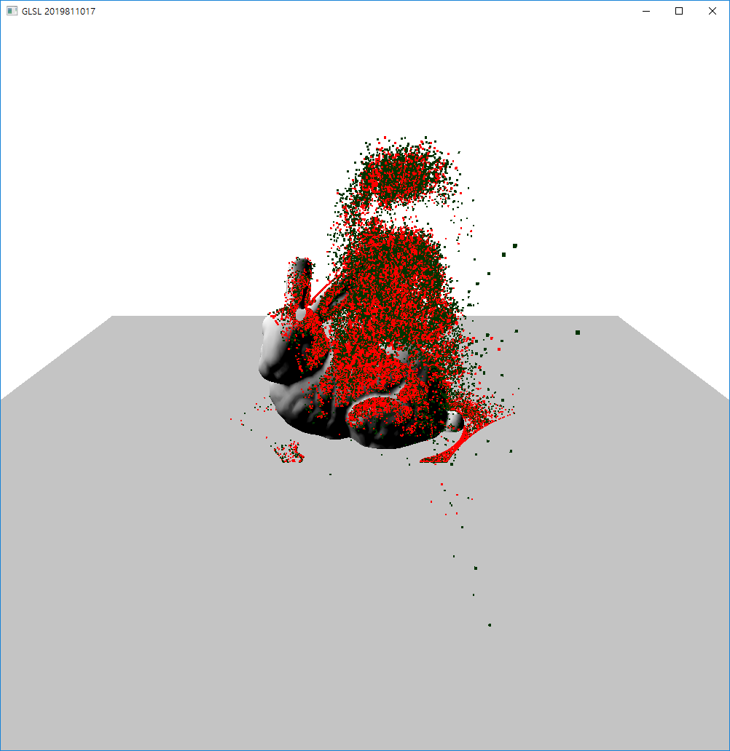

Slide 17
토끼 B밀도
5
10
15
20

Slide 18
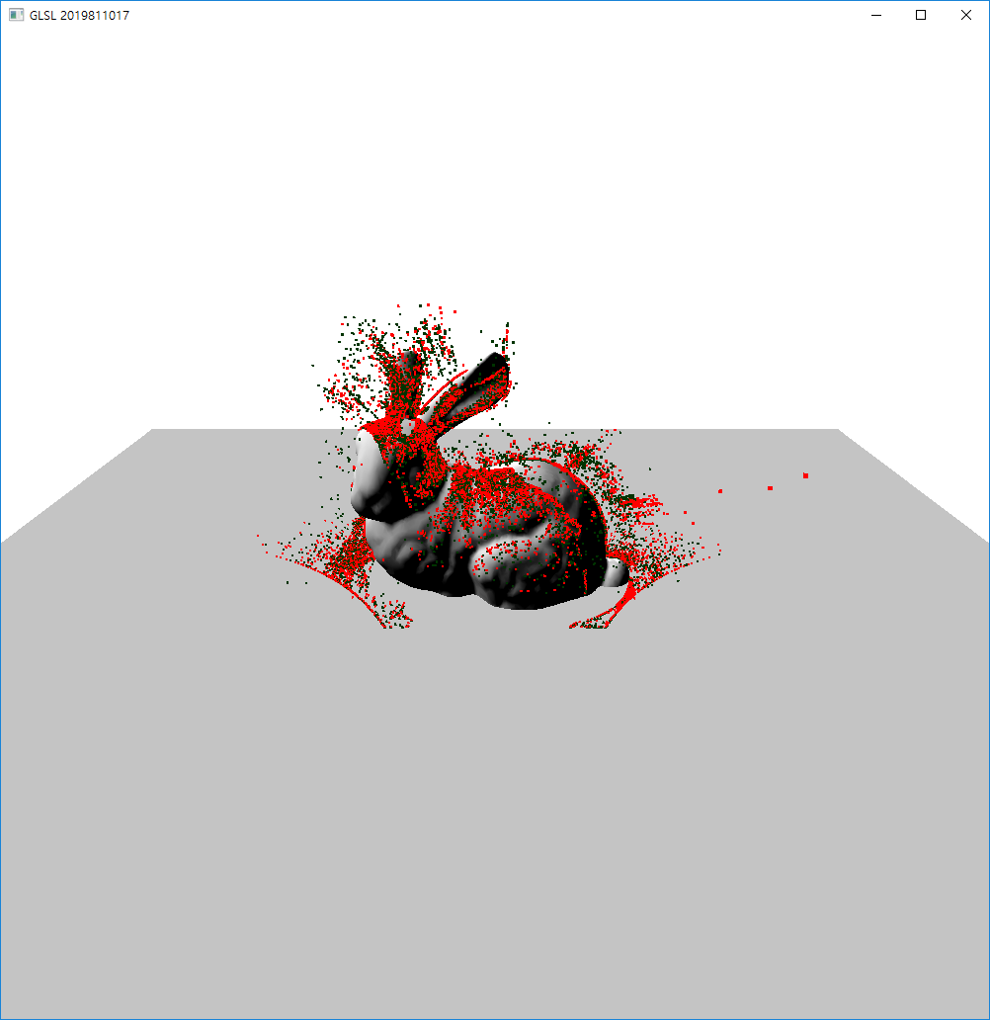
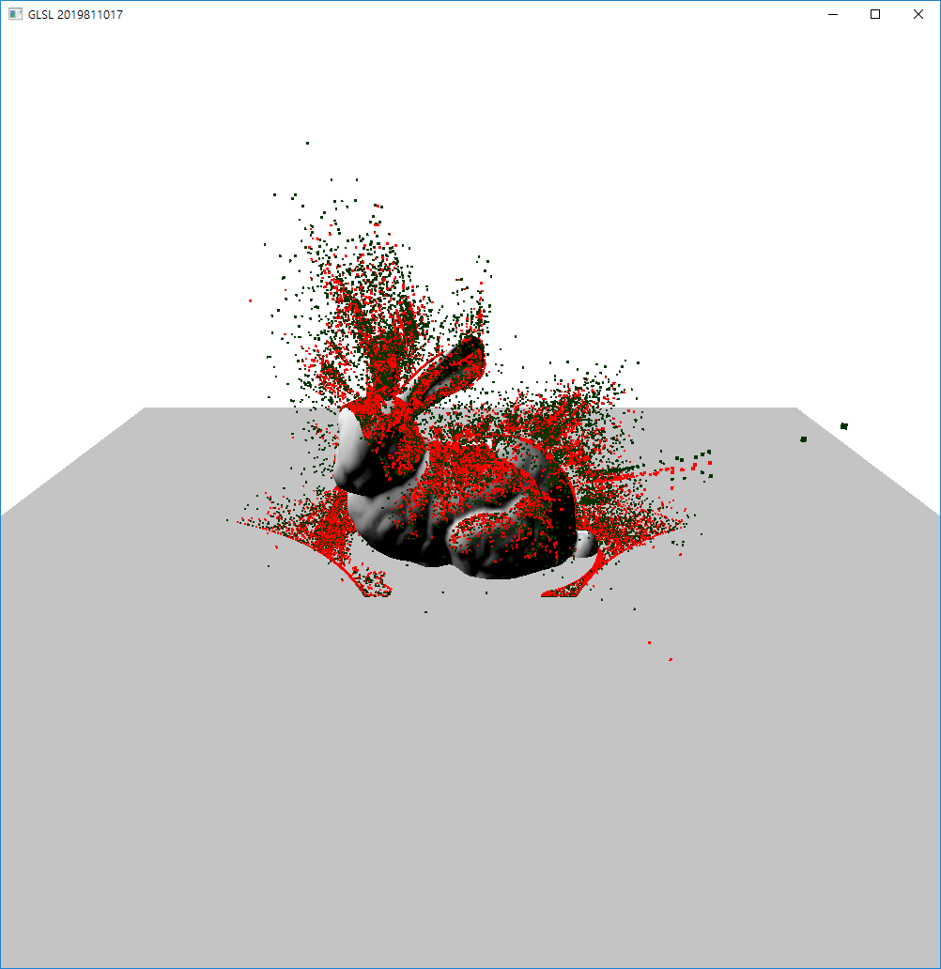
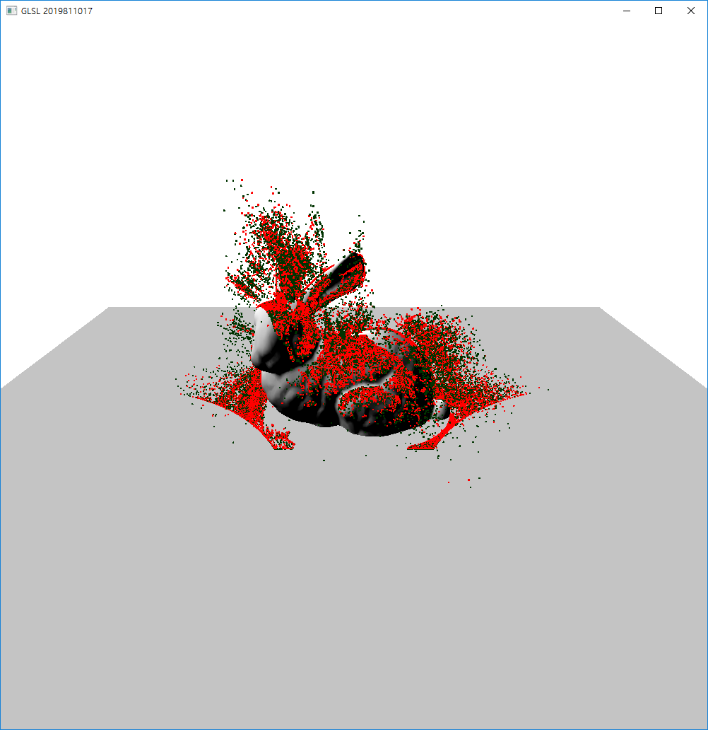
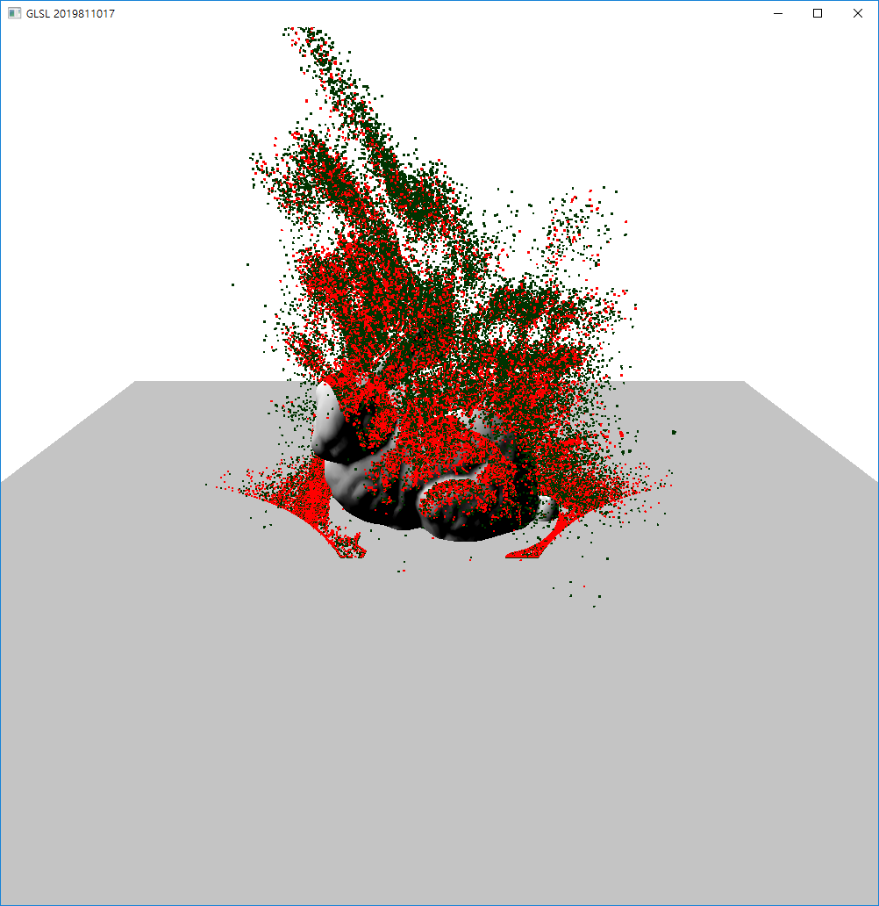

Slide 23
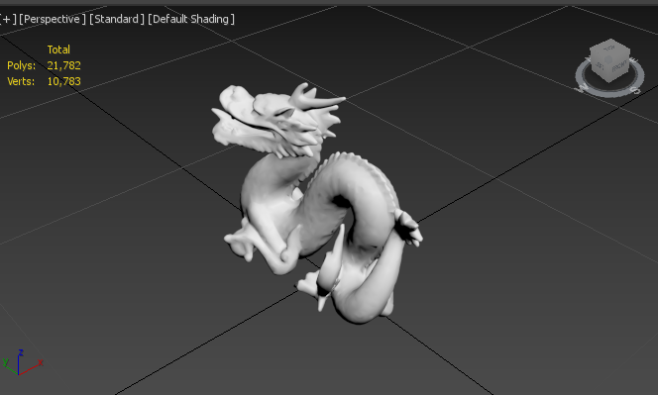
용 A 밀도
5
10
15
20

Slide 24
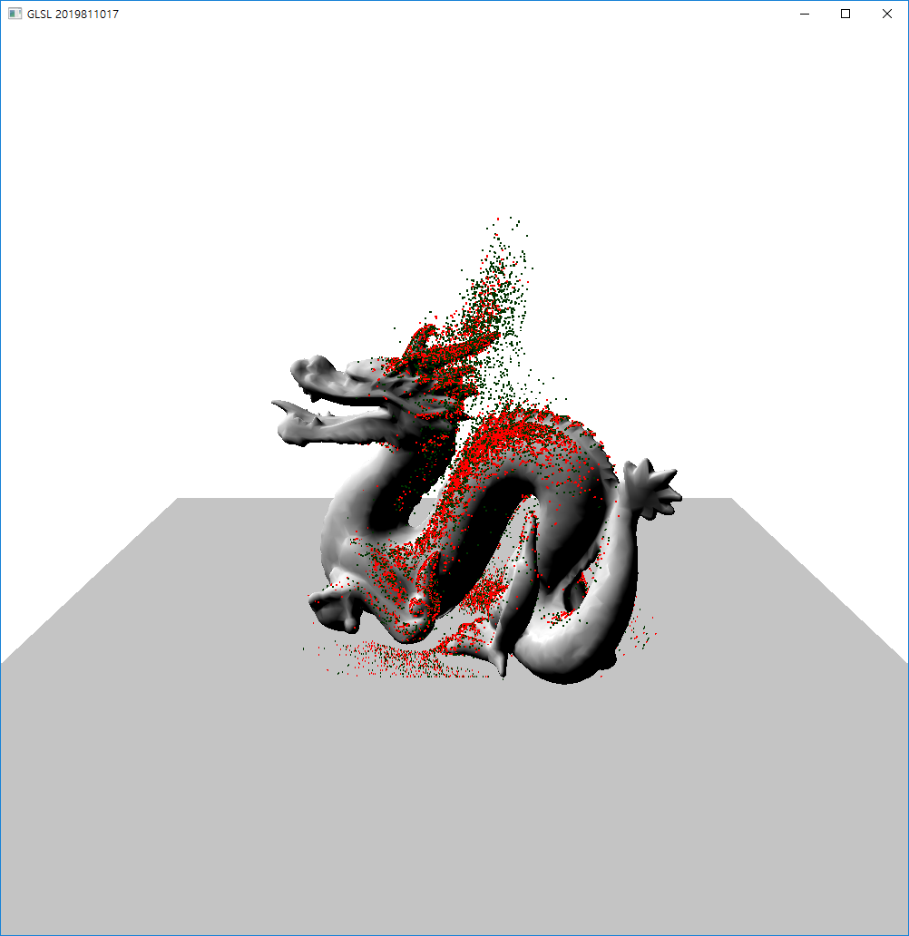
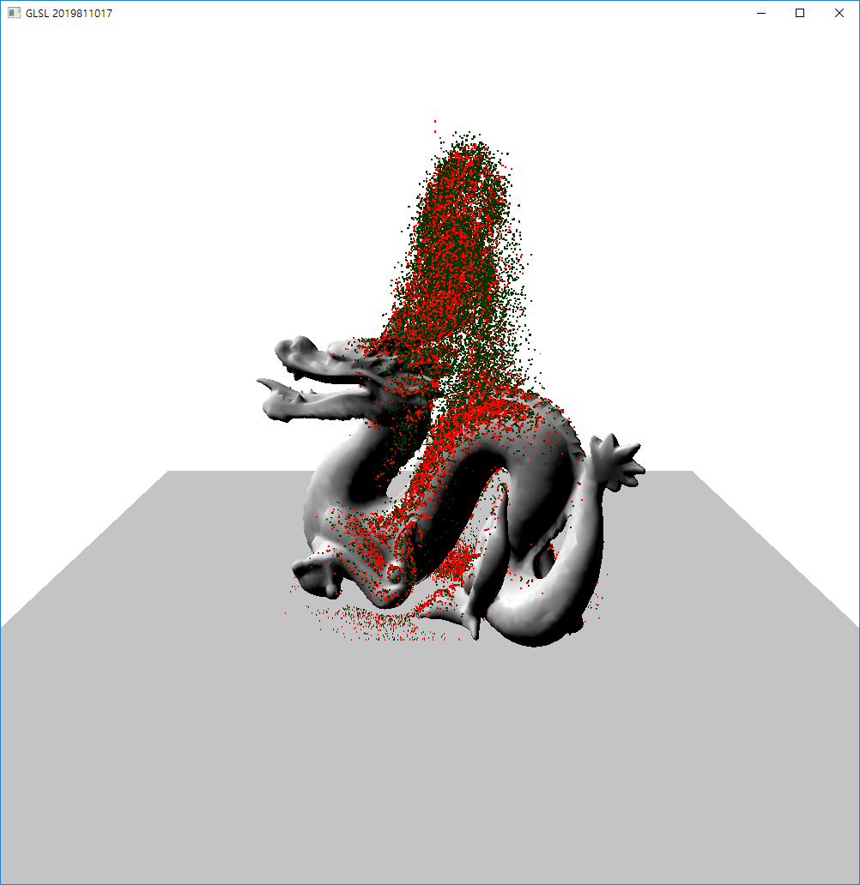
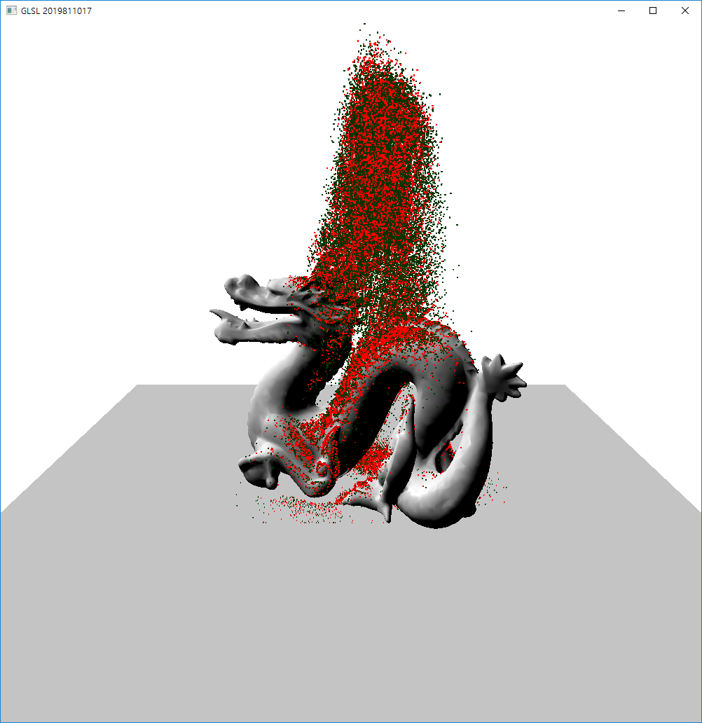
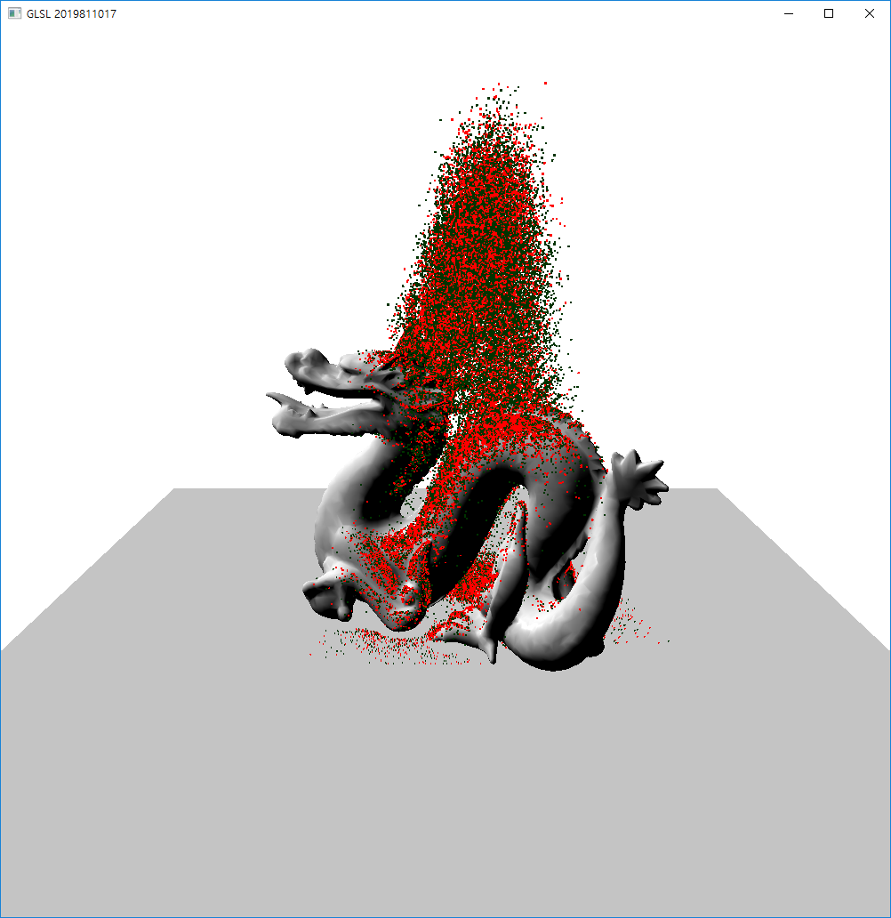

Slide 29
용 B 밀도
5
10
15
20

Slide 30
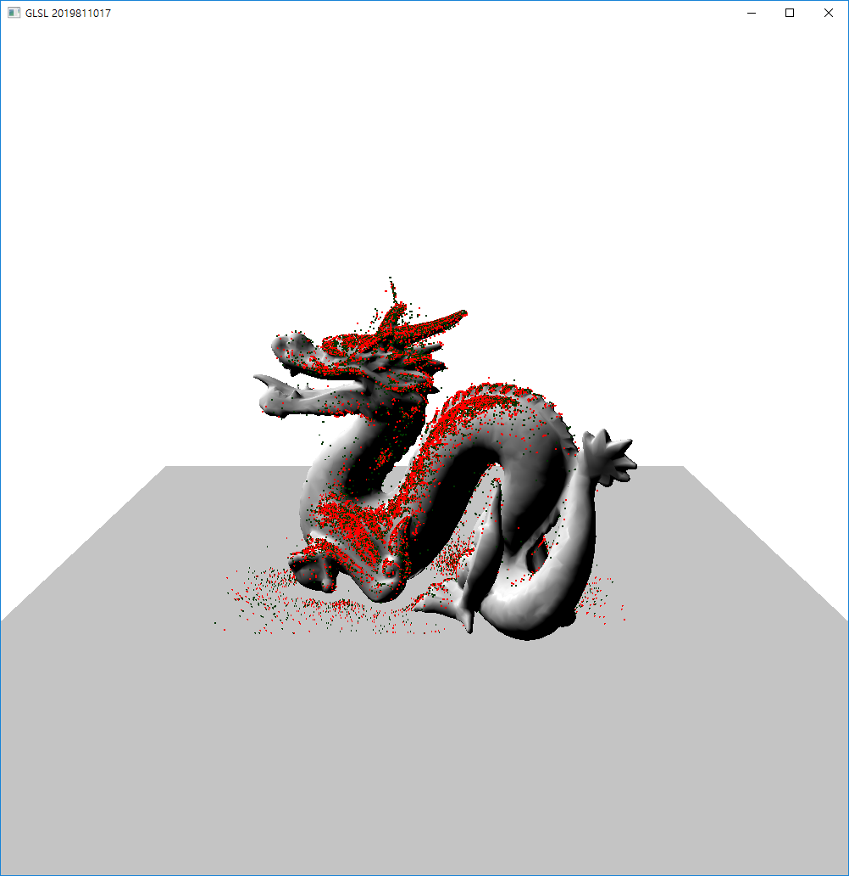
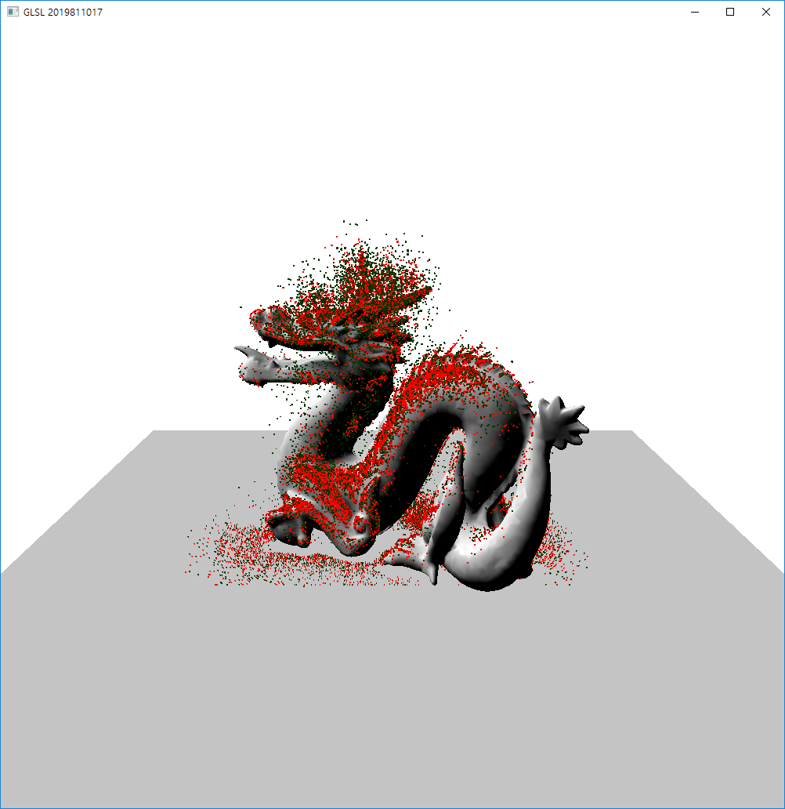
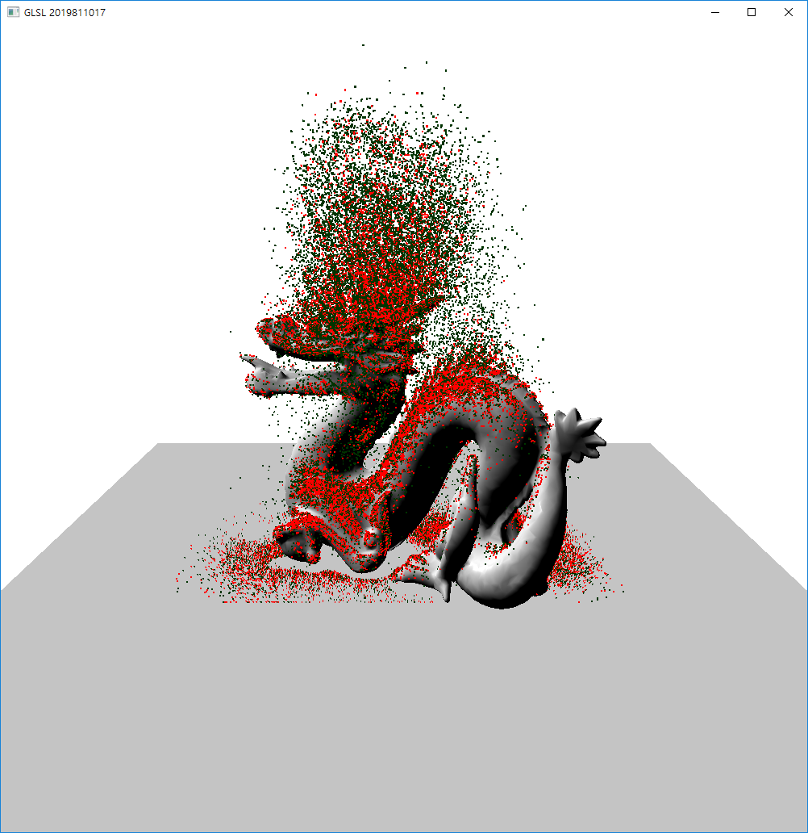
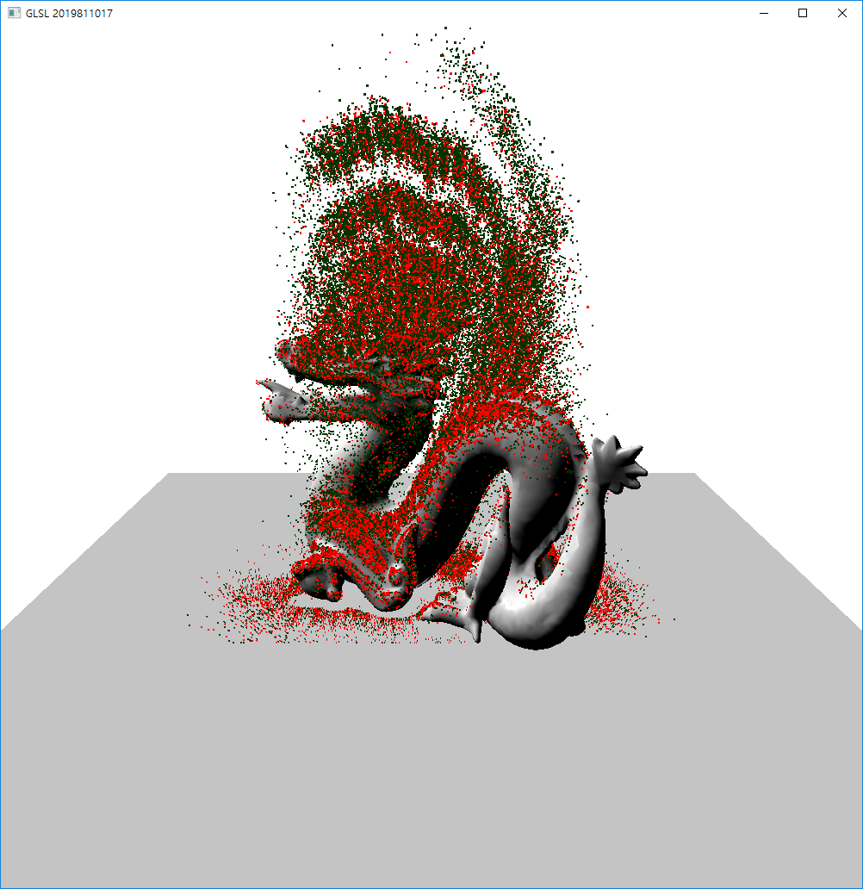

Slide 35
Mesh | 밀도 타입 | 파티클 개수(개)
 |  | 50,000 | 100,000 | 150,000 | 200,000
Rabbit | A | 19 | 40 | 75 | 96
 | B | 26 | 54 | 97 | 129
Dragon | A | 20 | 51 | 75 | 100
 | B | 28 | 59 | 114 | 160

Slide 36
+tx +ty
Base
texel
-tx
-ty

Slide 38
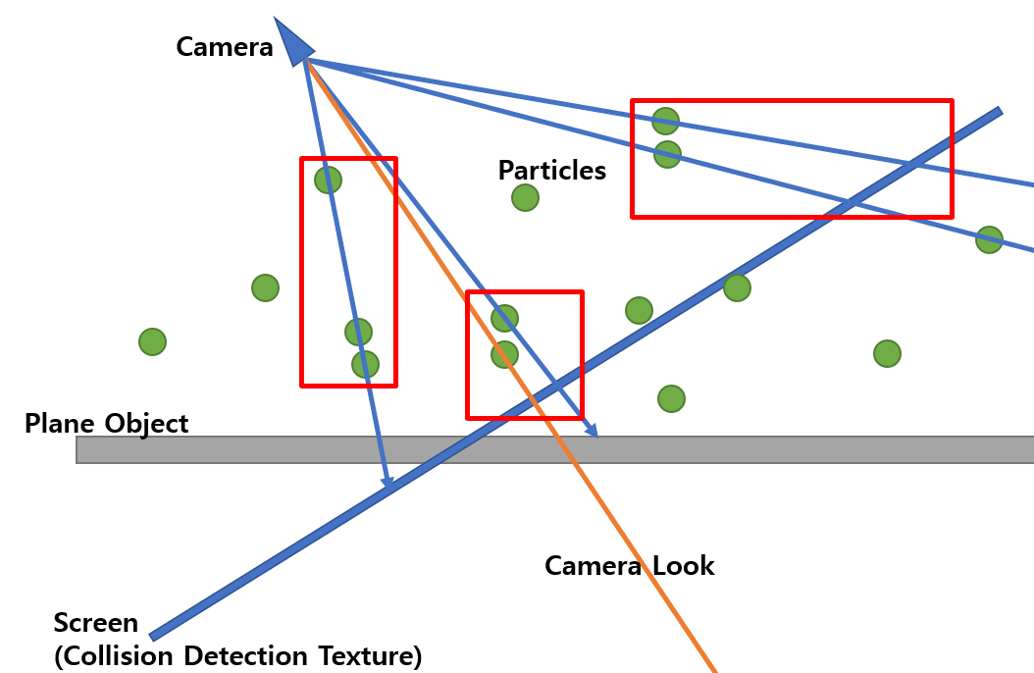
Group 3
Group 1
Group 2

Slide 39
Next Draw
Transform Feedback Buffer Object 2
Draw
Transform Feedback Buffer Object 1
Collision Pass
Collision Pass
Vertex Shader
Geometry Shader
Fragment Shader
CDT
Transform Feedback Buffer Object 2
Render Pass
Render Pass
Vertex Shader
Geometry Shader
Fragment Shader
Rendering

Slide 40
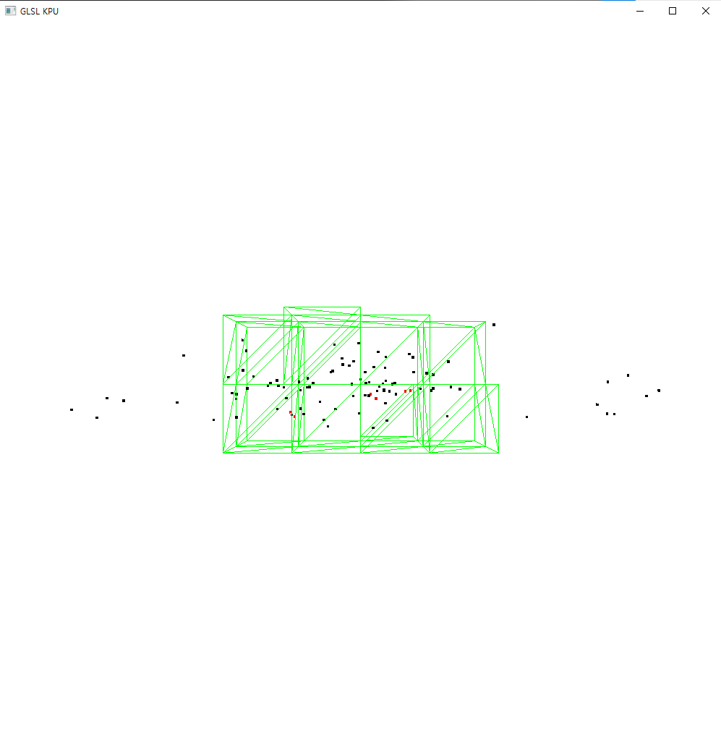
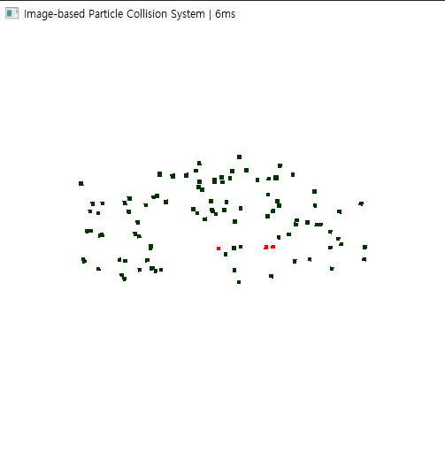
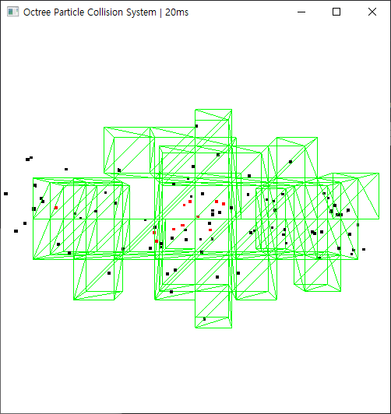
Octree Collision
CDT Collision

Slide 41
Collision Method | Particle Number
 | 50,000 | 100,000 | 150,000 | 200,000
CDT | 65 | 80 | 110 | 144
Octree | 85 | 159 | 200 | 243

Slide 42
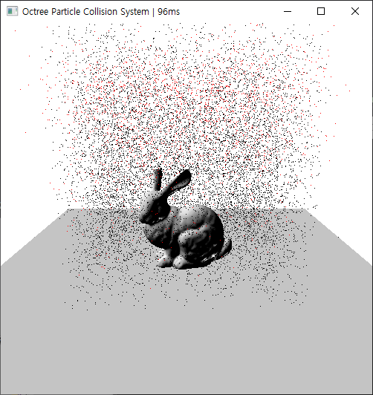
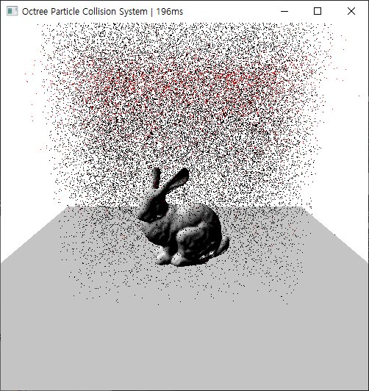
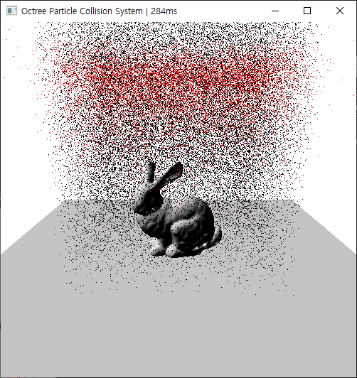
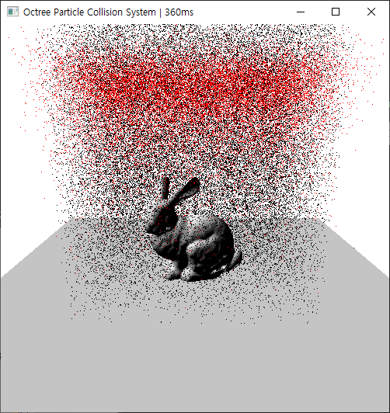
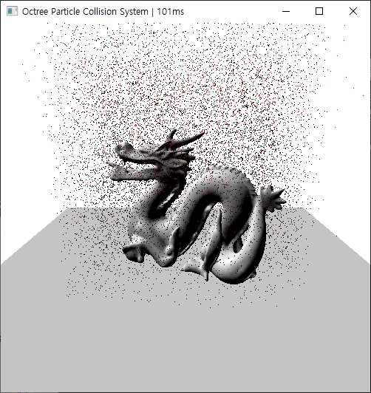
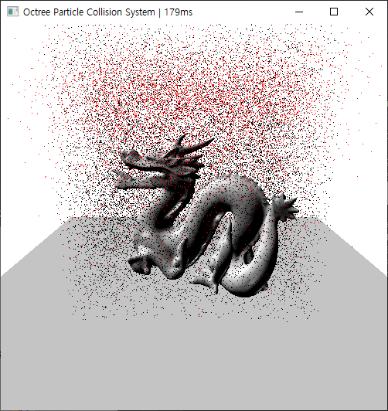
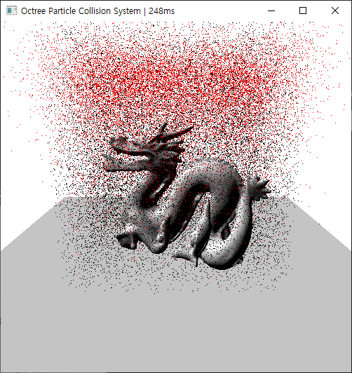
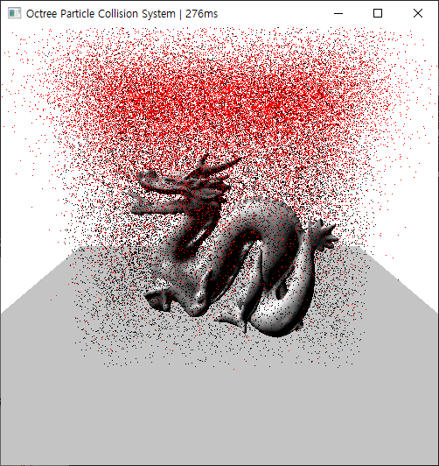

Slide 44
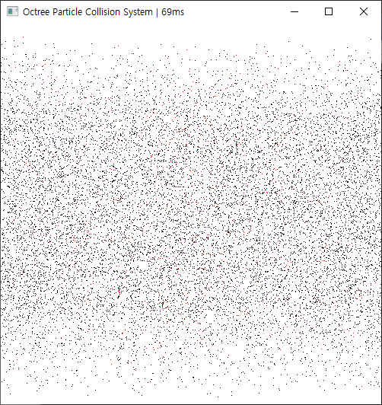
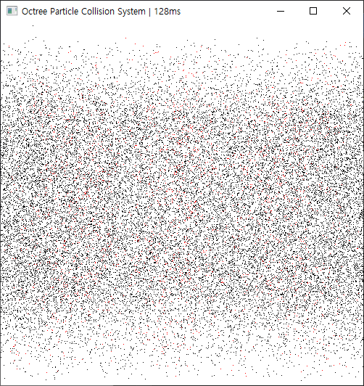
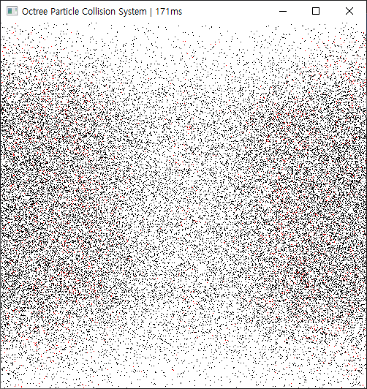
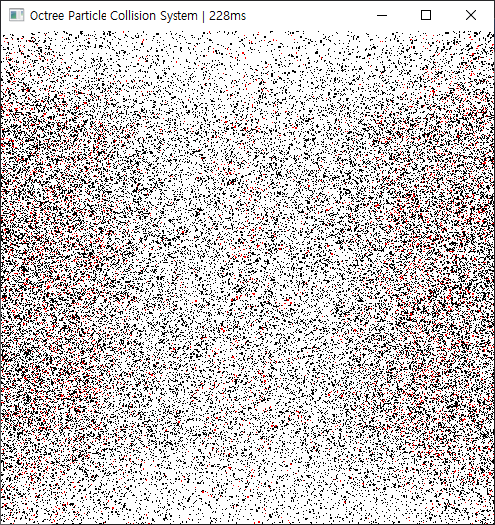
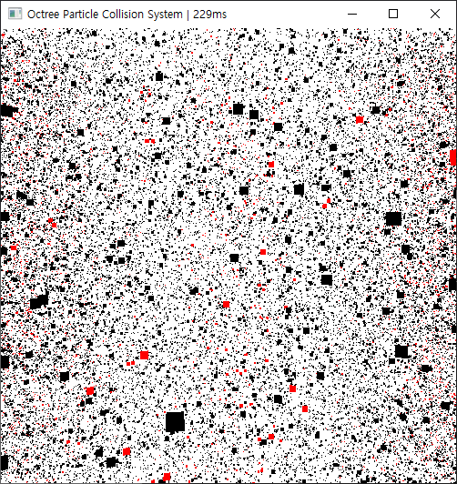

Slide 45
